Slide 1


MIPI Controller Core Overview
MIPI_Controller_Core_Overview_1_08
Northwest Logic Confidential

Slide 2
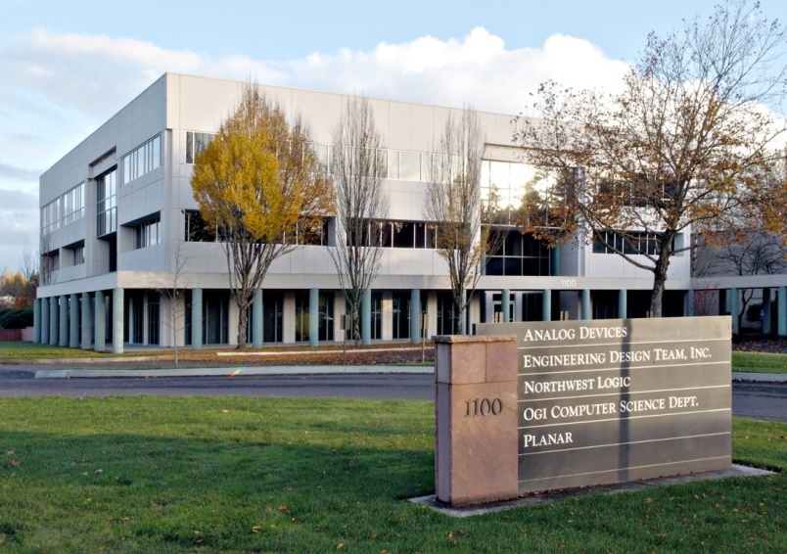
Northwest Logic Overview
Founded in 1995
Located in Beaverton, Oregon
Provide IP Cores
Memory Interface Solution
PCI Express Solution
MIPI Solution
Peripheral Cores
Complete Cross-Platform Support
Standard Cell ASIC
Structured ASIC
FPGA
Supplement with Design Services
IP Core Customization
Logic, Board, Software Services

Slide 3
Why Use Our IP Cores?
Silicon-proven, high-quality cores
High performance – high throughput, high clock rate, low latency
Easy to use - simple user interface, easy to configure, etc.
Optimized for use in ASICs and FPGAs
Fully hardware validated
Provided with a full featured Testbench
Development boards and driver support available
Available as source code
Core license includes expert technical support
Customization and integration services available
Widely used - references available

Slide 4
CSI-2 Controller Cores

Slide 5
Simplified CSI-2 Chip Architecture
CSI-2 Transmitter
CSI-2 Receiver

Slide 6
CSI-2 Tx Controller Core Architecture

Slide 7
CSI-2 Rx Controller Core Architecture

Slide 8
CSI-2 Controller Core Key Features
High-performance, easy-to-use core
Fully CSI-2 Specification compliant
Implements all 3 CSI-2 MIPI Layers (Pixel to Byte packing, Low Level Protocol, Lane Management)
Transmitter and Receiver Versions
Support 1-8 data lanes
Support all data types
Operates using Byte Lane Clock
Minimizes power and timing closure challenges
Single, double or quad pixel user interface
Optional Hsync/Vsync video interface
Error injection/collection support
Delivered fully integrated with target MIPI PHY
Minimal ASIC gate count
Easy configuration and control via core ports
Provided as source code
Provided with expert technical support
Provided with a CSI-2 Testbench
Customization and integration services available
FPGA-Based Demo System available

Slide 9
Pixel Clock Rates
Pixel clock rate must be greater than the MIPI data rate
Data Lanes | Lane Rate (Mbit/s) | Total Data Rate (Mbit/s) | Pixels Per User Clock | Pixel Width (bits) | Min Pixel Rate (MHz)
1 | 1000 | 1000 | 1 | 8 | 125
1 | 1500 | 1500 | 1 | 8 | 187.5
1 | 1500 | 1500 | 1 | 10 | 150
2 | 1000 | 2000 | 1 | 8 | 250
2 | 1500 | 3000 | 2 | 8 | 187.5
4 | 1000 | 4000 | 2 | 8 | 250
4 | 1500 | 6000 | 2 | 10 | 300
4 | 1500 | 6000 | 4 | 8 | 187.5
8 | 1000 | 8000 | 4 | 8 | 250
8 | 1500 | 12000 | 4 | 10 | 300

Slide 10
CSI-2 Testbench
CSI-2 Bus Functional Model
Simulates CSI-2 Rx/Tx operation
Very easy to use
Very fast
Complete data logging
Included with the CSI-2 Controller Cores
See CSI-2 Testbench User Guide for more information

Slide 11
CSI-2 Rx Testbench
CSI-2 Tx Controller provided with a CSI-2 Rx Testbench
Data Gen provides known data source
Controller delivered integrated and verified with target D-PHY model

Slide 12
CSI-2 Tx Testbench
CSI-2 Rx Controller provided with a CSI-2 Tx Testbench
Data Checker verifies data is properly received
Control Block controls operation
Controller delivered integrated and verified with target D-PHY model

Slide 13
CSI-2 Controller Deliverables
CSI-2 Controller Core
Core (Verilog)
User Guide
Fully integrated and verified with target D-PHY
Provided with CSI-2 Testbench
Expert Technical Support
IP Support
Optional services available (IP customization, logic development, etc.)

Slide 14
DSI Controller Cores

Slide 15
Simplified DSI Chip Architecture
DSI Host
DSI Peripheral

Slide 16
DSI Host Controller Core Architecture

Slide 17
DSI Peripheral Controller Core Architecture

Slide 18
DSI Controller Core Key Features
High-performance, easy-to-use core
Fully DSI Specification compliant
Implements all 3 DSI MIPI Layers (Pixel to Byte packing, Low Level Protocol, Lane Management)
Host and Peripheral Versions
Supports 1-4 data lanes
Support for all data types
Operates using Byte Lane Clock
Minimizes power and timing closure challenges
Flexible packet interface
Supports up to 4 virtual channels
Optional DBI, DPI, AXI (control) interfaces
Delivered fully integrated with target MIPI PHY
Minimal ASIC gate count
Easy configuration and control via core ports
Provided as source code
Provided with expert technical support
Provided with a DSI Testbench
Customization and integration services available
FPGA-Based Demo System available

Slide 19
DSI Testbench
DSI Bus Functional Model
Simulates DSI Host/Peripheral operation
Very easy to use
Very fast
Complete data logging
Included with the DSI Controller Cores
See DSI Testbench User Guide for more information

Slide 20
DSI Peripheral Testbench
DSI Host Controller provided with a DSI Peripheral Testbench
Data Gen provides known data source
Controller delivered integrated and verified with target D-PHY model

Slide 21
DSI Host Testbench
DSI Peripheral Controller provided with a DSI Host Testbench
Data Checker verifies data is properly received
Control Block controls operation
Controller delivered integrated and verified with target D-PHY model

Slide 22
DSI Controller Deliverables
DSI Controller Core
Core (Verilog)
User Guide
Fully integrated and verified with target D-PHY
Provided with DSI Testbench
Expert Technical Support
IP Support
Optional services available (IP customization, logic development, etc.)

Slide 23
For More Information
Visit our website at: www.nwlogic.com
Has more information on our Products and Capabilities
Use website to generate Info Request
Will provide access to secure section of the website
Has all of the product datasheets, app notes, user guides, etc.
Contact Brian Daellenbach at:
briand@nwlogic.com
503-533-5800 x309

